Slide 1



Engineering ITSM Through Site Reliability Engineering
Jayne Groll
CEO
DevOps Institute

Slide 2

About Me
Co-founder and CEO of the DevOps Institute, former ITIL instructor, former IT Ops Director, frequent speaker. Author of the Agile Service Management Guide.
@JayneGroll
@DevOpsInst

Slide 3

Become a member at www.devopsinstitute.com
About
DevOps Institute
We drive human transformation in the digital age.
DevOps Institute is a professional member association with one mission: to advance the human elements of DevOps.
We create a safe and interactive ecosystem where members can
network, gain knowledge, grow their careers, lead and initiate, and
celebrate professional achievements.
We inspire thought leadership and knowledge by connecting and
enabling the global member community to drive human transformation
in the digital age.

Slide 4


INTRODUCTION
WHAT IS SITE RELIABILITY ENGINEERING (SRE)?
SRE PRINCIPLES
AGENDA
SRE APPROACH TO ITSM PRACTICES
SRE IN INDUSTRY
SUMMARY

Slide 5

Digital transformation is no longer optional.
n rmal
The New
You can’t be digital if you aren’t reliable.

Slide 6
What is Site Reliability Engineering (SRE)?

Slide 7
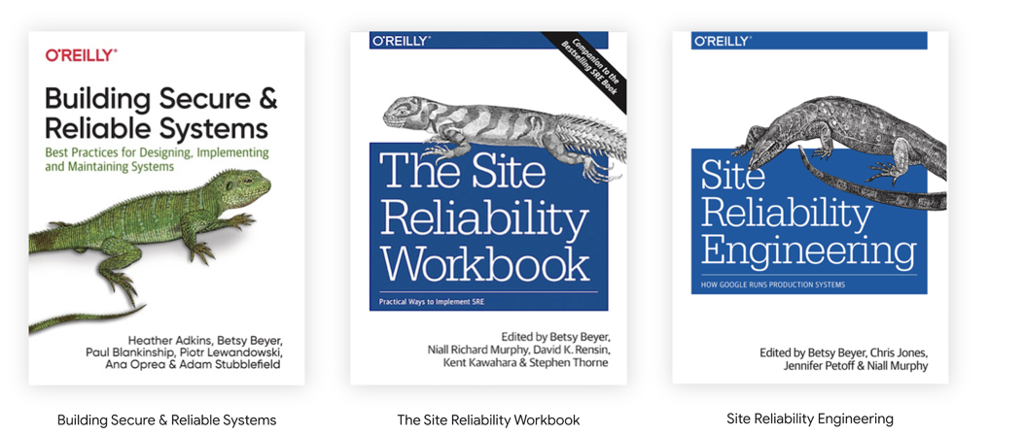
“SRE is what happens when you ask a software engineer to design an operations function”
Ben Treynor Sloss, Google
https://landing.google.com/sre/books/

Slide 8
Google Considers SRE its Approach to Service Management
An SRE team is responsible for the availability, latency, performance, efficiency, change management, monitoring, emergency response and capacity planning of their service
Rules are codified for how SRE teams interact with their environment –not only in production but with product development teams, testing teams, users, etc.

Slide 9
SRE is the capstone element of a self-regulating software delivery system.
Agile Software Development
(Develop)
DevOps
(Build and Deploy)
Site Reliability Engineering
(Operate)
SRE principles and practices closely align with those of Agile and DevOps making collaboration more frequent and more productive.

Slide 10
SRE Principles

Slide 11




Guiding SRE Principles (1)
Service Level Objectives
Self- organization
Proactive Time
Continuous Learning
Managing Service Level Objectives (SLOs) with consequences.
The ability to regulate their workload
Time to make tomorrow better than today
Failure is an opportunity to improve

Slide 12
Embrace Risk
Service Level Objectives
Monitor Distributed Systems
Eliminate Toil
Guiding SRE Principles (2)
Automation
Simplicity
Release Engineering

Slide 13
Engineering Reliability through Service Management

Slide 14
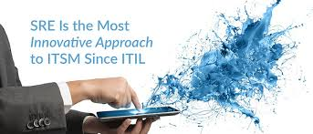
Google refers to SRE as it’s Approach to Service Management

Slide 15
Systems Engineering for Service Management
SRE engineers service management as a system that is
Lightweight
Integrated
Self-regulating
Inclusive
Accountable
Automated
Proactive

Slide 16






Service Level Management
Change Management
Event Management
Capacity Management
Incident Management
Problem Management
Let’s explore how SRE engineers some of these key ITSM practices.

Slide 17

Service Level Management
Manage to Service Level Objectives (SLO)
Measure by Service Level Indicators (SLI)
Per SRE, the term SLA is overloaded and takes on a number of meanings depending on context.
Notes:
Latency – how long to fulfill
The term SLA is overloaded and taken on a number of meanings depending on context.
Service Level Indicator (SLI) – quantitative measure of some aspect of a service that is provided (e.g., latency, throughput, availability)
Service Level Objective (SLO) - a target value \ that sets expectations on how a service will perform (measured by SLIs).

Slide 18

Change Management
Error Budgets
Automation
Increased release velocity
Removing humans minimizes the number of users and operations exposed to bad changes and avoids normal problems of fatigue, familiarity/contempt and inattention to highly repetitive tasks.
Notes:
Latency – how long to fulfill
The term SLA is overloaded and taken on a number of meanings depending on context.
Service Level Indicator (SLI) – quantitative measure of some aspect of a service that is provided (e.g., latency, throughput, availability)
Service Level Objective (SLO) - a target value \ that sets expectations on how a service will perform (measured by SLIs).

Slide 19

Event Management
Latency
Traffic
Errors
Saturation
SRE advocates for a reactive and proactive approach by observing the environment from both an internal and external perspective (Observability).
Notes:
Latency – how long to fulfill
The term SLA is overloaded and taken on a number of meanings depending on context.
Service Level Indicator (SLI) – quantitative measure of some aspect of a service that is provided (e.g., latency, throughput, availability)
Service Level Objective (SLO) - a target value \ that sets expectations on how a service will perform (measured by SLIs).

Slide 20

Capacity Management
Organic growth (natural usage)
Inorganic growth (event driven)
Since capacity is critical to availability, SRE teams are in charge of capacity planning and provisioning.
Notes:
Latency – how long to fulfill
The term SLA is overloaded and taken on a number of meanings depending on context.
Service Level Indicator (SLI) – quantitative measure of some aspect of a service that is provided (e.g., latency, throughput, availability)
Service Level Objective (SLO) - a target value \ that sets expectations on how a service will perform (measured by SLIs).

Slide 21

Incident Management
Incident Command System
Recognized Command Post
Live Incident State Document
Clear, Live Handoff
On Call
An Incident Commander structures the incident response, assigns responsibilities, removes roadblocks and keeps a living incident document.
Notes:
Latency – how long to fulfill
The term SLA is overloaded and taken on a number of meanings depending on context.
Service Level Indicator (SLI) – quantitative measure of some aspect of a service that is provided (e.g., latency, throughput, availability)
Service Level Objective (SLO) - a target value \ that sets expectations on how a service will perform (measured by SLIs).

Slide 22
Problem Management (Effective Troubleshooting)
Problem Report
Triage
Examine
Diagnose
Test/Treat
Cure
Blameless post-mortems are a tenet of SRE culture and must focus on identifying the contributing causes of the incident without indicting any individual or team.
Notes:
Latency – how long to fulfill
The term SLA is overloaded and taken on a number of meanings depending on context.
Service Level Indicator (SLI) – quantitative measure of some aspect of a service that is provided (e.g., latency, throughput, availability)
Service Level Objective (SLO) - a target value \ that sets expectations on how a service will perform (measured by SLIs).

Slide 23








SRE Also Provides Tangible Guidance On
EMERGENCY RESPONSE ON-CALL
LOAD BALANCING
SECURITY
SOFTWARE ENGINEERING IN SRE
MANAGING OPERATIONAL LOAD
COMMUNICATION AND COLLABORATION
RELIABLE PRODUCT LAUNCHES

Slide 24
Isn’t SRE more technical than traditional ITSM?
Durable focus on engineering
Toil reduction
Time to innovate and upskill
Intelligent process engineering is needed for intelligent automation.

Slide 25


SRE is On the Rise
SRE Adoption Has Risen From 10% Adoption In 2019 To 15% In 2020 (Upskilling 2020: Enterprise Devops Skills Report)
Site Reliability Engineer Is The Fifth Fastest Growing IT Role For 2020 (Linkedin Report)

Slide 26




Site Reliability Engineer is a Real Job
Over 10,000 posted jobs in the US, most paying over $100K

Slide 27

THANK YOU
Jayne Groll
@JayneGroll
www.devopsinstitute.com

